Slide 1

ECO MANIA
moving towards greenery....
Presented by: ERROR-404

Slide 2

MOTIVATION:
Our nature as well as humans getting affected
Careless and reckless use of nature and natural resources.
Increasing Global Warming,use of plastics,unbalanced climatic conditions.
Lack of knowledge about how to maintain sustainability

Slide 3
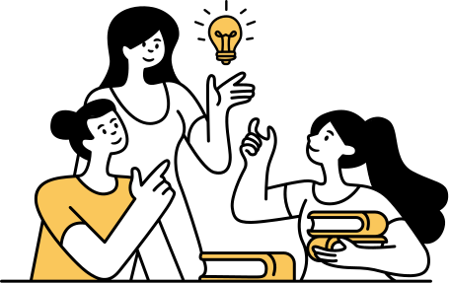
THE PROBLEM:
Deforestation
Pollution(soil,air,water,materials etc)
Excessive Poaching
Construction works etc

Slide 4




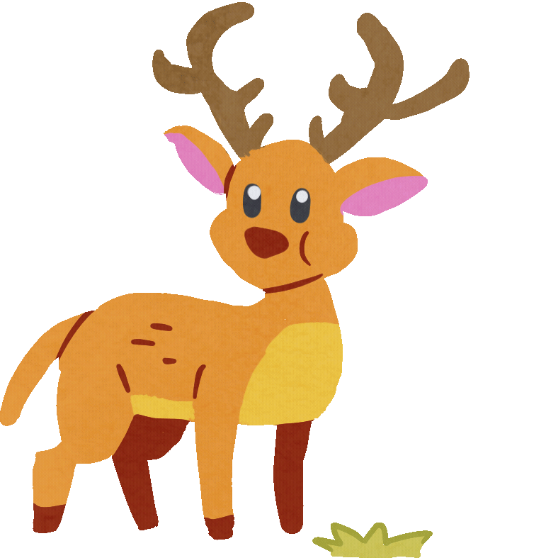


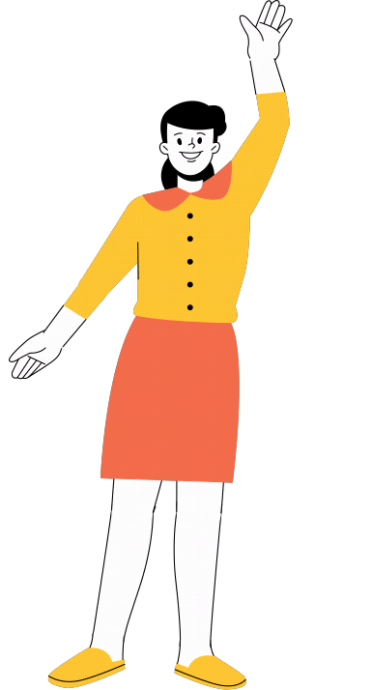
THE PROBLEM:

Slide 5


THE SOLUTION:
There are several approaches to this problem such as:
Creating Awareness among the population : NGOs,environmental awareness programmes,educating the communities
-Technical ways:Using Renewable Sources of energy like solar,wind,hydroelectric power
-Device apps: Games,news,websites,media etc

Slide 6
ROOT ISSUE:
Creating a holistic approach towards sustainability to save our environment.

Slide 7
FEATURES OF ECO MANIA
Our app Eco Mania aims to encourage the people to save our Mother Earth,awares about how our ecosystem is gradually deteriorating,the increasing amount of global warming, melting of glaciers etc;and helps the people to contribute their little step for improving our environment.

Slide 8
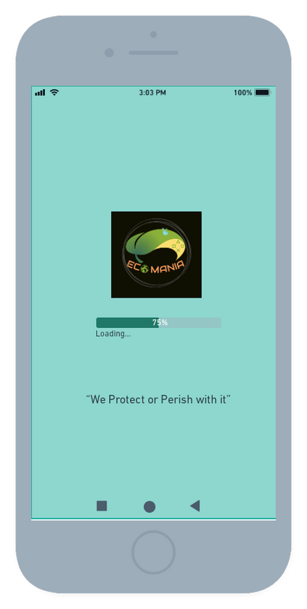
FEATURES OF ECO MANIA
It opens with it's logo and loads with some motivation quotes related to protection of our environment.

Slide 9
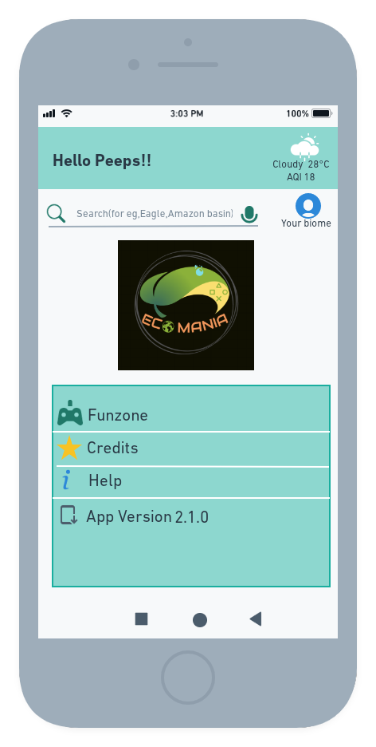
FEATURES OF ECO MANIA
A dashboard appears which consists of Search bar,games,credits,help
Search button:it directs to the chrome,wiki or any info website where people can explore and can be updated about various facts and news about nature.
(P.S-The "search" icon will only show results related to our nature,otherwise there will be no results.)
Climate and Weather:keep us up-to-date with current's temperature,climate and air quality index.

Slide 10
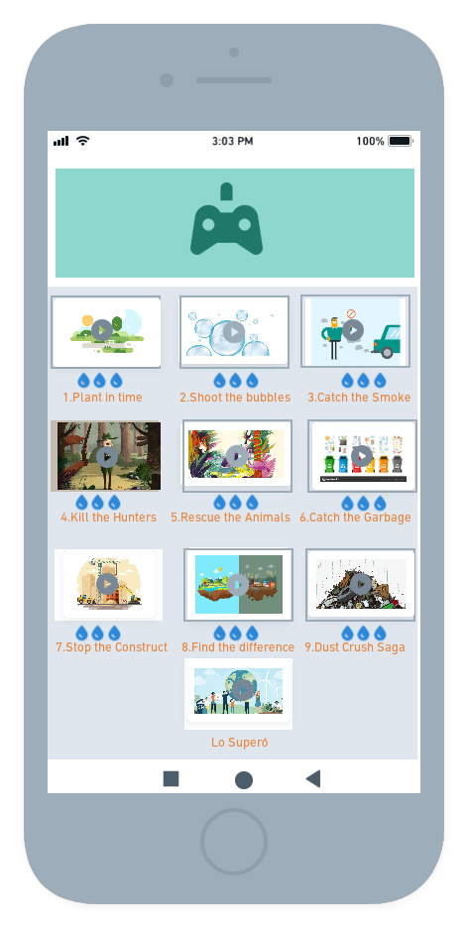
FEATURES OF ECO MANIA
A fun and productive game which consists of 8-10 levels and their trials are marked by number of droplets.

Slide 11
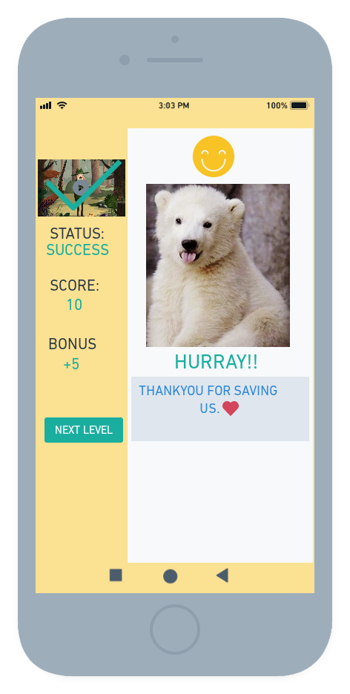
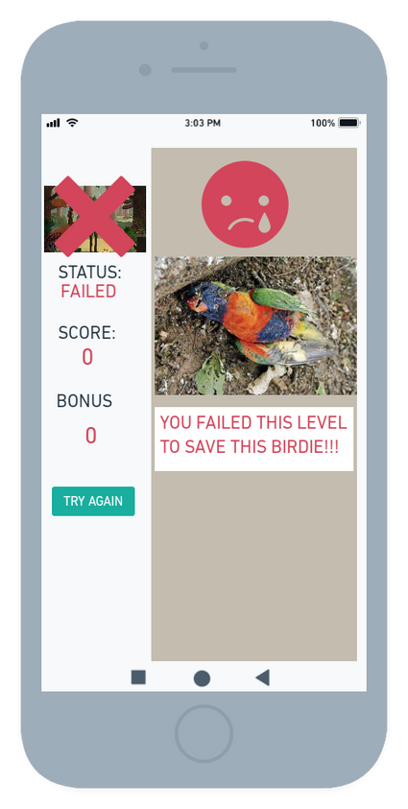
FEATURES OF ECO MANIA
If the user passes the level, it will state " Hurray!! Thankyou for saving us" with an image or gif which shows happy environment.
If the game overs,a small image or gif appears on the screen which shows a dead bird/drought image/,a dying koala etc with a statement "You failed this level to save the adorable birds"

Slide 12
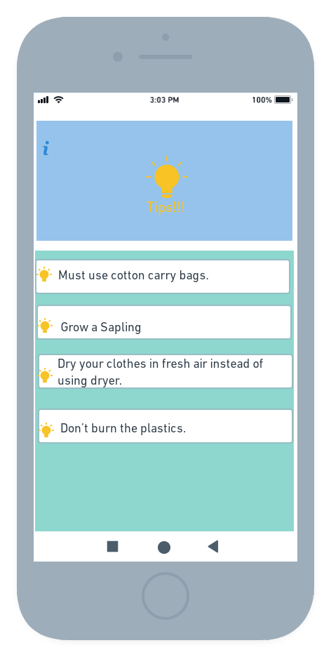
FEATURES OF ECO MANIA
Some tips which can contribute to the saving of our Mother Earth.

Slide 13
TECHNOLOGY USED:
FLUTTER
MY SQL
DIGITAL OCEAN
LARAVEL
TENSORFLOW
XML DESIGN
IEZA
RRF

Slide 14
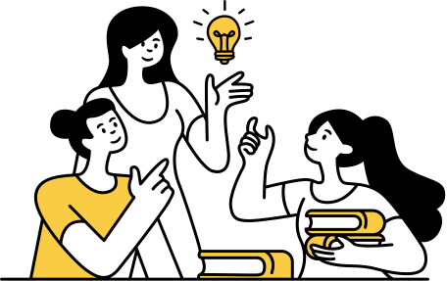
APPLICABILITY
This app is for everyone.for all age groups,mainly focuses on youth.
Can be used by the high school students,professionals etc working on environmental issues or projects;

Slide 15
FUTURE SCOPE:
Uniqueness:
There is hardly any application which provides this much amount of support and features we are planning to provide.
Commercialisation:
We have planned to commercialize our app by creating a marketing strategy anfd user personas,promoting on social,can also be commercialized by some Advertisements consisting eco friendly products such as bicycles,smoke caps,recycled goods etc
Solving Environmental issues:
Our solution is aiming at saving our environment from individual to whole world level.

Slide 16
THE NEXT!!
Improve similarity Algorithms
Run pilot with NGOs,and Environmental Educators;
Reaching out for public officials and public demands.

Slide 17

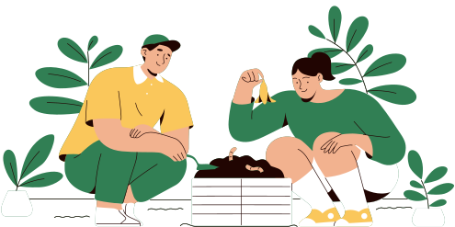
THANK YOU
THE TEAM
ERROR-404
Sushree Das
Kiran Kumar Das

